Slide 1
CMSI ecalj course feb.22.2016
目標： ecaljパッケージ（QSGW法）で何がどの程度できるのか？
自分の目的に使えるかどうか？,可能性を知ってもらう． →共同研究
セッション１（10:30~１２：００）
LECTURE1: イントロ，PMT= LAPW+LMTO. ecaljでの一体問題解法
PRACTICE１：インストールとLDAでのバンドプロット．
セッション２（1:１５~１４：３０）+
セッション３（１４：４５~１６：１５．．．）
LECTURE2: Quasiparticle self-consistent GW method
QSGW近似で何ができるか？LDAの欠点がどのように解消するか？
何ができるか？
PRACTICE２： DOS，PDOSのプロット，QSGWでのバンドプロット．
スピン軌道相互作用
その他の話題
ワニエ関数法，有効相互作用算出,インパクトイオン化

Slide 2
ecalj package
Github にて管理，公開．
tkotani ecaljで検索．Gitによるバージョン管理
ワークショップ資料，ecaljmanual.pdfを含む
（詳細な開発者向きドキュメントは分離して管理）．
利便性を意識（M1の学生を想定）．
独自性の高いPMT＝LAPW+LMTO，QSGW法を元にしたコード体系
また，そのための技術を利用した手法．
LDA,GGA,構造緩和，LDA+U, ワニエ関数法，
スピン軌道相互作用（コリニア），GW, QSGW，誘電関数，
スピン帯磁率，フォノン（進展中）
最適化が弱い点：並列化（ｋ点並列のみ）．構造緩和．
研究活動の戦略
１．全エネルギーに関わるもの
２．原子位置はあまり動かないもの
プログラム・方法開発者
（小谷ら）
実験・研究現場
（実験のわかる）理論家
＋学生

Slide 3
The PMT method: a new linearized method Takao Kotani (tottori-u)
PMT =APW + MTO
Muffin-tin
Key point:
1. Iteration cycle.
2. eigenfunctions are expanded with
APWs(augmented plane wave)
and MTOs(muffin-tin orbital)
Notes:
I thank to organizers prof.Ebert, diemo, and Ogura-san for the invitation to this meeting.
My talk is about a new linearlized method, the PMT method.
…
PMT means APW+MTO.
APW is the augmented plane wave.
MTO is the muffin-tin orbital, which is the atomic-centered augmented wave.
As this name stand for, the PMT method is a mixed basis linearized method,
which uses both of the augmented wave together.
My talk is as follows.
At the next page, my motivation. I explain why I started the PMT.
Then I will remind you what is the linearized method, APW, and MTO.
Then you will see why the PMT method can be important..
The I will give a few key points in its theoretical formulation.
Then I will show recent results on the homonuclear diatomic molecules in the PBE exchange-correlation calculations.

Slide 4
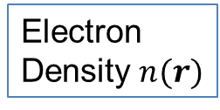
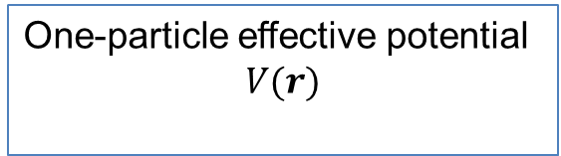
Independent particle picture and total energy
These can be obtained by the density functional theory (DFT) in LDA.
Electron
Density $n(r)$
DFT in LDA
One-particle effective potential
$$V(r)$$
Fill up to Fermi energy
iteration
cycle
This iteration cycle until converged = total energy minimization

Slide 5
How to represent density and so on in computer?
How to solve it numerically?
Lists of the Full-potential methods
KKR
Pseudopotential method
PAW
LMTO
LAPW
Linearized xxx methods
(why do we call them ” linearized” method?
→from the view of “exact ” APW method)
Notes:
…
Until now
I expect such a method should be

Slide 6
Finite basis set
Basis set (finite number of basis)
→ We assume eigenfunctions are given as:
Finite dimension problem(as the same as LCAO/Gaussian)
Notes:
Let us remind the framework of the linear method.
In the method two key quantities are
→Minimize the total energy with respect to alpha_p^I
If we fix psi_p, minimization is done with respect to this coefficient alpha.
Note that F_j can changes when we move atoms.

Slide 7
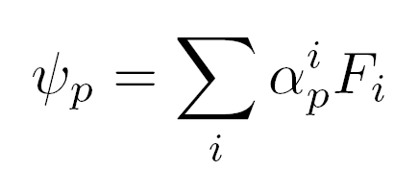
iteration cycle
previous iteration
Next iteration
Notes:
This is the flow chart of the linearized method to attain the total energy minimization.
Augmented wave can be determined with the knowledge of V(r).
Augmentation can be independent of V(r)
Or are set up from MT part of the potential.

Slide 8
How to choose the good basis?
APW (augmented plane wave)
MTO ( muffin-tin orbital)
are the names of the basis functions.
Both of them are made by “augmentation”.
My conclusion:
To overcome shortcomings in APW basis and MTO basis, we should use both of APW and MTO together.
→this means the PMT method
What is the APW and MTO?→ next page.
Notes:
Faster is better.
Improvement as for

Slide 9
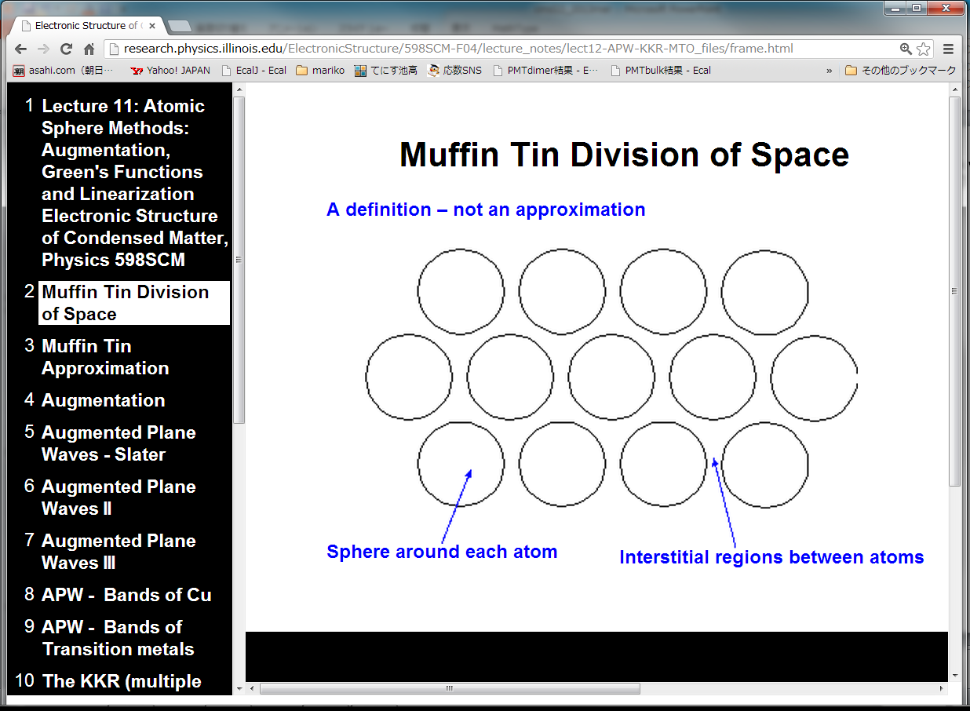
MT regions
Interstitial region
http://research.physics.illinois.edu/ElectronicStructure/598SCM-F04/lecture_notes/

Slide 10
Envelope function = PlaneWave(PW)
ＡＰＷ
PW in MT
MT region
MT region
3-components
PW ＋ Atomic-like part － Counter part:
PW within MT
0th 1st 2nd
Good for Na(3s), high energy bands.
Not so good for Cu(3d), O(2p)
Systematic
Notes:
This is a schematic view of APW.
APW
Atomic-like functions consist of linear combination of two atomiic-like waves for each lm channel,
The linear combination is so that they are continiously connected to the envelope functions as for value and slope.
Schematic view of APW

Slide 11
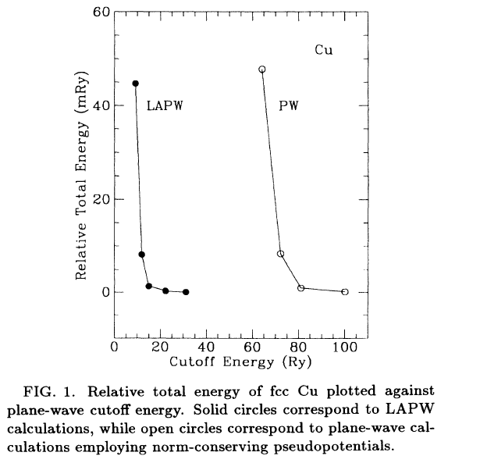
Linearized APW
fcc Cu
plane wave is not
so efficient for 3d
15Ry or more for
~1mRy convergence
D.Singh et al PRB49,17424
Notes:
~15Ry or more is required for ~1mRy convergence
This too large cutoff is only used to describe shape of eigenfunction around atom.
Why do we need such large cutoff? → This is because of the nature of PW.

Slide 12
ＭＴＯ
Atom-centered Hankel function, e.g,
Smooth Hakel function
MT region
MT region
3-components
Hankel ＋ Atomic-like part － counter part of Hankel
0th 1st 2nd
Good for localized orbitals such as Cu(3d), O(2p)
Ｎot so good for extended states, surface.
Not systematic
Notes:
To treat conduction bands for Si or so, we need empty sphere.
It will be very difficult to treat atoms on surface and so on
Atom-centered Hankel function. (in practice we use smoothed Hankel function)..
Hankel is a solution of a flat potential.
Smooth charge can not → we use smoothed Hankel function

Slide 13
PMT =APW + MTO
T.K and M.van Schilfgaarde Phys. Rev. B 81, 125117 (2010)
T.K， H. Kino, and H.Akai
Supercell calculations from H2 through Kr2.
Almost automatic setting of MTOs with APWs
(Energy cutoff 3~4Ry) .
J. Phys. Soc. Jpn. 82, 124714(2013)
J. Phys. Soc. Jpn. 84, 034702 (2015)
Notes:
So, some year ago, I got conclusion that I have to develop this method.
Use MTO and APW together..
As we explained, the eigenfuncitons in solids can look like APW or MTO,
So the method fits to the eigenfunctions in real materials.
These are results for solids, MTOs are not controlled well,
formulation is unclear..
Such dimers are not so easily treated in these methods.

Slide 14
Basis function
Envelope function
PW or smHankel
Atomic-like parts
for
Counter part
for
Augmentation parts
Cutoff:
Radial-part expansion
Electron density $n\left(r\right)$ and potential $V(r)$ are expanded in a similar manner.
Notes:
A basis consists of the three components.
For simplicity, consider the case with an atom in a cell with periodic boundary condition.
Spin index is now shown explicitly.
Augmentation procedure can be dependent on the basis set.
Expanded in the spherical Harmonics.
J is the index for a basis function
Envelope function PW or Hankel functions.
True part within MT site a.
This parenthes means a set of functions for MTs.

Slide 15
Local orbitals(lo): basis functions which are Non-zero only wihtin MTs.
e.g, see http://www.wien2k.at/lapw/index.html
This is also used together.

Slide 16
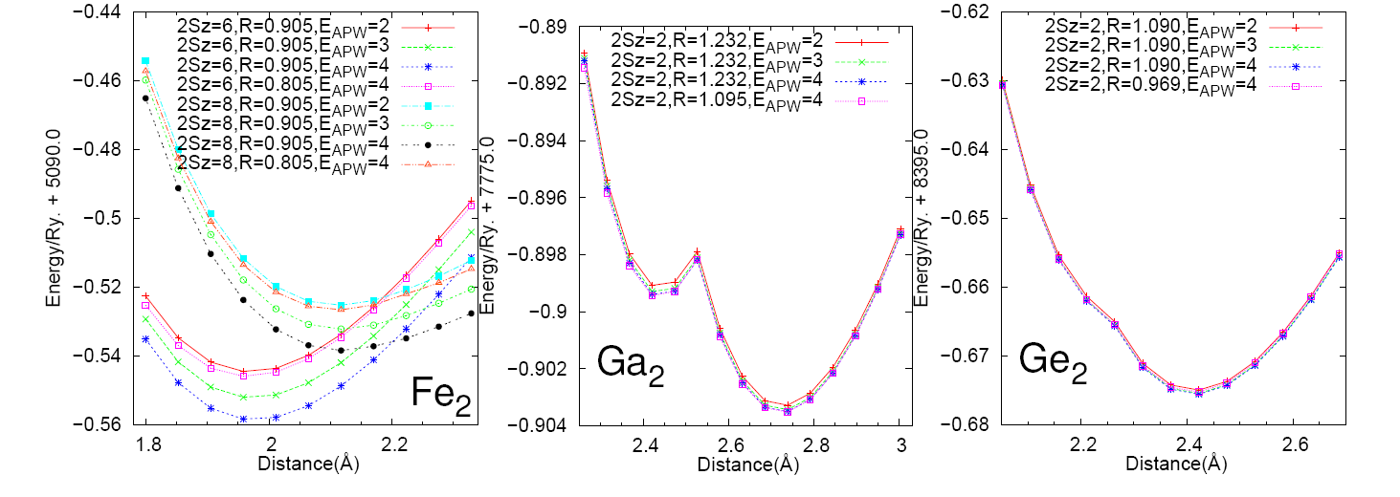
N_{basis}=1081+36×2, 1973+36×２, 3025+36×２

Slide 17
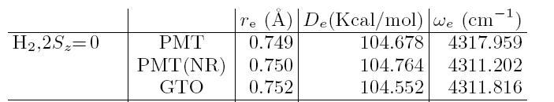
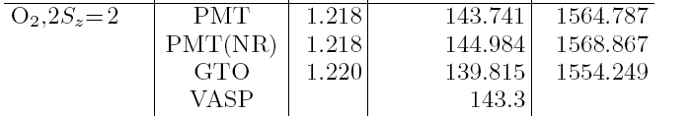
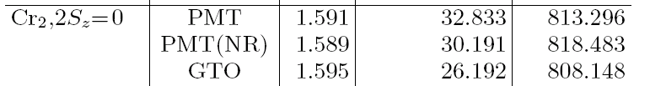
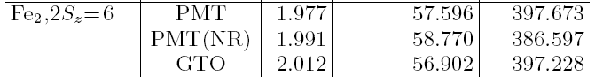
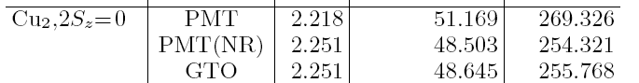
Comparison with Gaussian
ＮＲ：non relativistic ＧＴＯ：6-311+G(d,p)

Slide 18
Quasiparticle self-consistent GW
Takao kotani(tottori university)
Mean field theory.
What the eigenvalue means?
GW, and QSGW method
Minimum and previous results.

Slide 19
Mean field theory gives an independent-particle picture
Hartree-Fock theory
Density functional theory
NOTE: we can consider
A. configuration of excited states. → QUIZ (picturize this)
B. fractional occupancy (this is very theoretical)
We can describe “ground state” and “excited state” easily by filling electron or removing electron from orbitals → Independent particle picture
But need to know its limitation.

Slide 20
True excited state energy is not so easy;
From a view, you can say “mean-field changes by filling electrons”.
Confusing? But there is a key theorem for mean-field theories.
Left hand side is “True” excitation energy.
(caution: this is “derivative”, not one-electron filled/removed.)

Slide 21
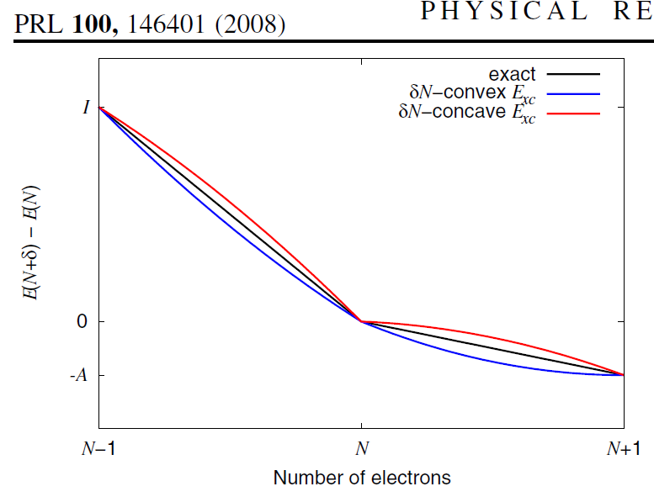
Ionization energy of an atom
A.J.Cohen, P. Mori-Sanchez, W.Yang, Science321,792(2008)
Vacuum level
LUMO
LUMO
HOMO
HOMO
HF LDA
How about solid (infinite system)?→

Slide 22
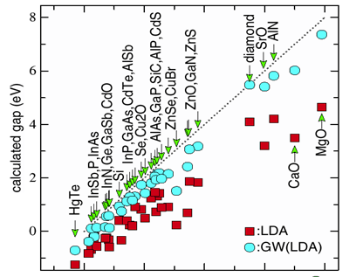
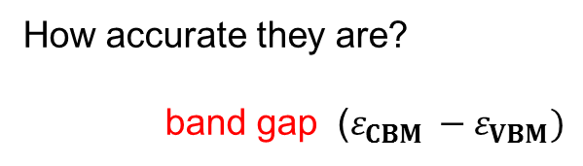
Conduction band
How accurate they are?
band gap ($ε_{CBM }−ε_{VBM})$
Band gap
Valence band
LDA gives too small
HF(not shown) gives too large
Experimental gap (eV)
Key point : meanings of “eigenvalues and eigenfuncions” in the mean-field theory.

Slide 23
GW method and QSGW method

Slide 24
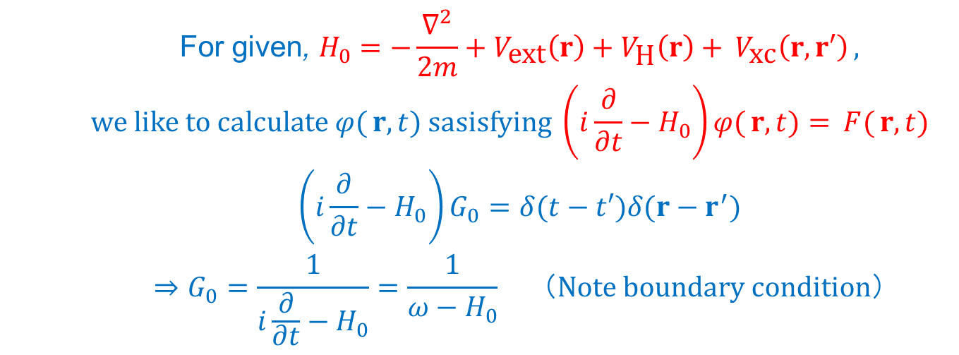
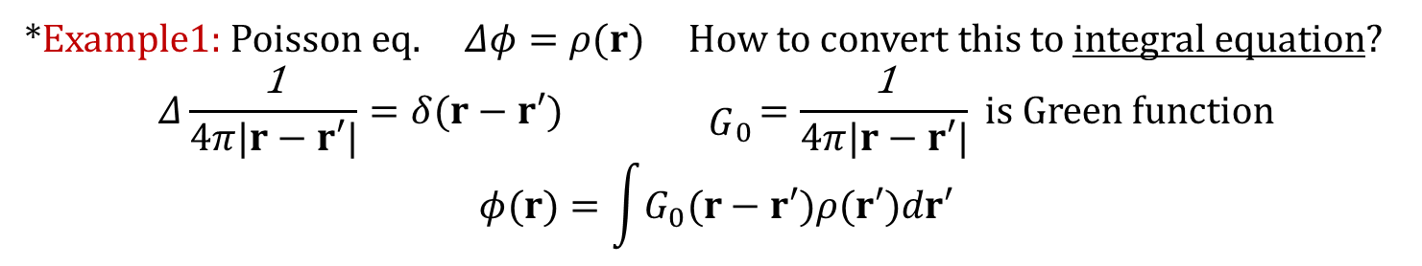
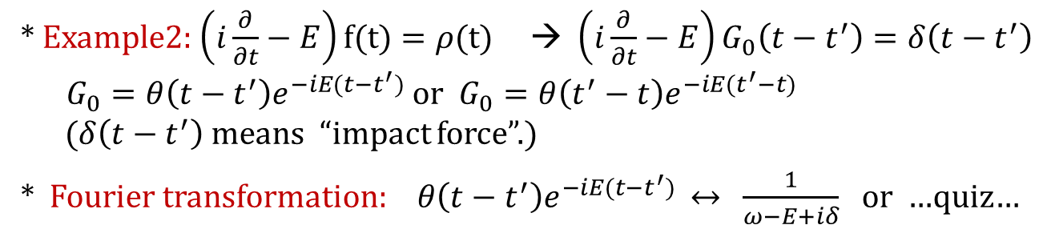
(preparation) What is Green’s function?
*Example1: Poisson eq. $Δφ=ρ(r)$ How to convert this to integral equation?
$$Δ\frac{\text{1}}{4π|r−r′|}=δ(r−r′) { \begin{aligned} \\ G\end{aligned}}_{0}=\frac{\text{1}}{4π|r−r′|} is Green function$$
$$φ(r)=\int{G_{0}(r−r′)ρ(r′)dr′}$$
* Example2: $\left(i\frac{∂}{∂t}−E\right)f(t)=ρ(t)$ → $\left(i\frac{∂}{∂t}−E\right)G_{0}\left(t−t^{′}\right)=δ\left(t−t^{′}\right)$
$G_{0}=θ\left(t−t^{′}\right)e^{−iE(t−t^{′})}$ or $G_{0}=θ\left(t^{′}−t\right)e^{−iE(t^{′}−t)}$
($δ\left(t−t^{′}\right)$ means “impact force”.)
* Fourier transformation:$θ\left(t−t^{′}\right)e^{−iE(t−t^{′})}$ $↔$ $\frac{1}{ω−E+iδ}$ or …quiz…
$$\begin{matrix}\text{For} \text{given}\text{, }H_{0}=−\frac{∇^{2}}{2m}+V_{\text{ext}}\left(r\right)+V_{\text{H}}\left(r\right)+ V_{\text{xc}}\left(r,r′\right) , \\ \text{we} \text{like} \text{to} \text{calculate} φ( r,t) \text{sasisfying} \left(i\frac{∂}{∂t}−H_{0}\right)φ( r,t)= F( r,t) \\ \left(i\frac{∂}{∂t}−H_{0}\right)G_{0}=δ(t−t′)δ(r−r^{′}) \\ ⇒G_{0}=\frac{1}{i\frac{∂}{∂t}−H_{0}}=\frac{1}{ω−H_{0}} （Note boundary condition）\end{matrix}$$
Notes:
Complete set. Orthogonal.

Slide 25
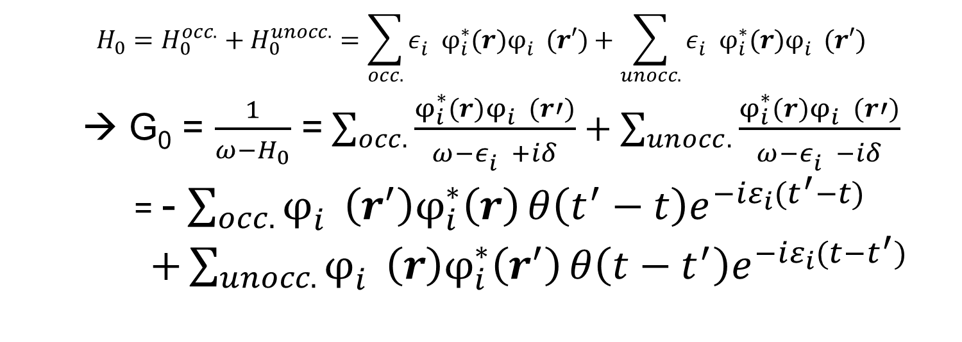
𝑩𝒐𝒖𝒏𝒅𝒂𝒓𝒚 𝒄𝒐𝒏𝒅𝒊𝒕𝒊𝒐𝒏 𝒂𝒍𝒐𝒏𝒈 time-axis
$$H_{0}=H_{0}^{occ.}+H_{0}^{unocc.}=\sum_{occ.}{{ε_{i}^{}φ}_{i}^{∗}(r)φ_{i}^{}(r′)}+\sum_{unocc.}{{ε_{i}^{}φ}_{i}^{∗}(r)φ_{i}^{}(r′)}$$
→ G₀ = $\frac{1}{ω−H_{0}}$ =$\sum_{occ.}{\frac{φ_{i}^{∗}(r)φ_{i}^{}(r′)}{ω−ε_{i}^{}+iδ}}+\sum_{unocc.}{\frac{φ_{i}^{∗}(r)φ_{i}^{}(r′)}{ω−ε_{i}^{}−iδ}}$
= - $\sum_{occ.}{φ_{i}^{}\left(r^{′}\right)φ_{i}^{∗}\left(r\right)}θ\left(t^{′}−t\right)e^{−iε_{i}(t^{′}−t)}$
$+\sum_{unocc.}{φ_{i}^{}\left(r\right)φ_{i}^{∗}\left(r^{′}\right)}θ\left(t−t^{′}\right)e^{−iε_{i}(t−t^{′})}$
(we measure $ε_{i}$ from $μ, or ε_{i} →$all excitation is positive energy)
Quiz: check this $G_{0}$ satisfy differential eq at page.24
Why? → this is convenient due to Fermi statistics
(adding electron or “adding hole=removing electron”).

Slide 26
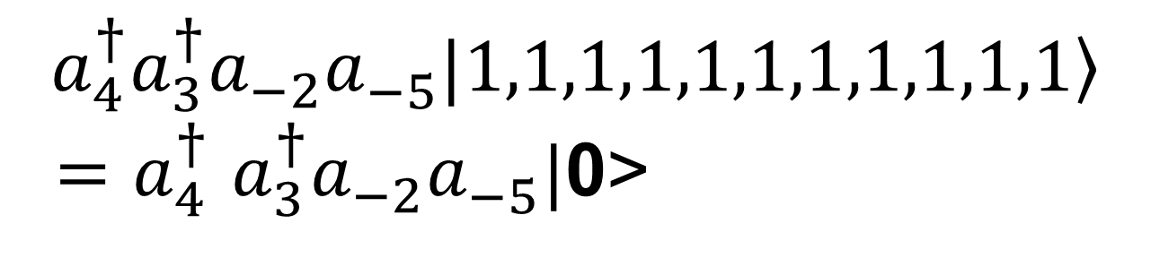
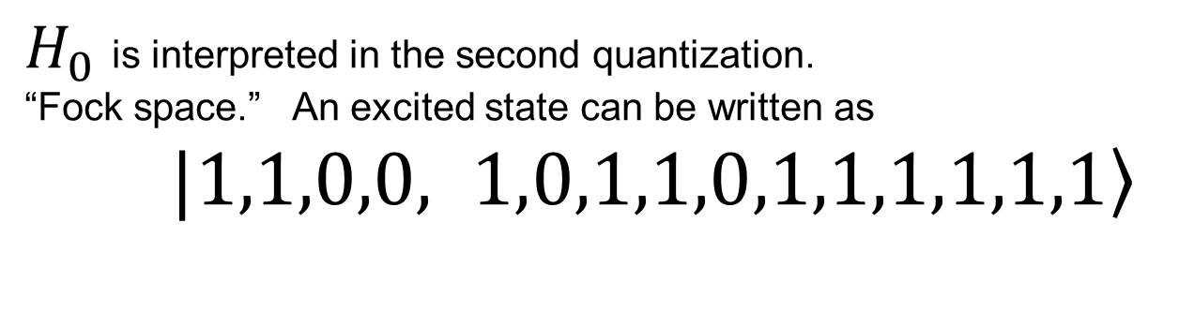
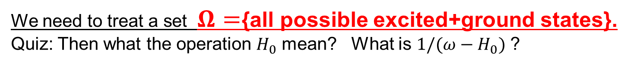
Many body theory (rough explanation)
$H_{0}$ is interpreted in the second quantization.
“Fock space.” An excited state can be written as
$|\left.1,1,0,0, 1,0,1,1,0,1,1,1,1,1,1\right\rangle$
Above Ef
Below Ef
Ef
In other words, it can be written as
$$a_{4}^{†}a_{3}^{†}a_{−2}^{}a_{−5}^{}|\left.1,1,1,1,1,1,1,1,1,1,1\right\rangle$$
${=a}_{4}^{†}a_{3}^{†}a_{−2}^{}a_{−5}^{}|$0>
We need to treat a set $Ω=${all possible excited+ground states}.
Quiz: Then what the operation $H_{0}$ mean? What is ${1/(ω−H}_{0})$ ?

Slide 27
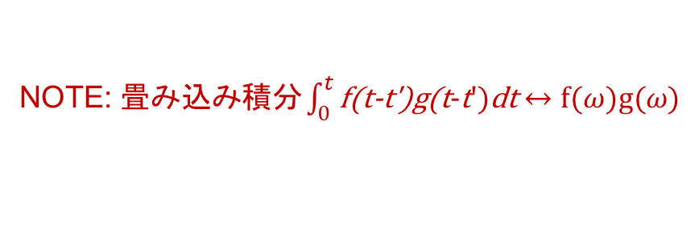
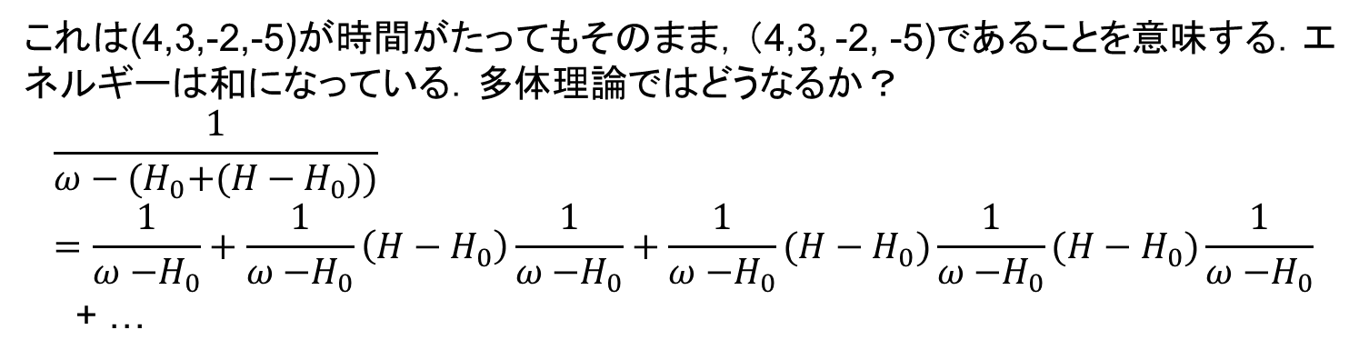
$${1/(ω−H}_{0}) in MBPT$$
時間軸
4
3
-2
-5
t
t’
これは(4,3,-2,-5)が時間がたってもそのまま，（4,3, -2, -5)であることを意味する．エネルギーは和になっている．多体理論ではどうなるか？
$$\frac{1}{ω−{{(H}_{0}+(H−H}_{0}))}=\frac{1}{ω{−H}_{0}}+\frac{1}{ω{−H}_{0}}\left(H−H_{0}\right)\frac{1}{ω{−H}_{0}}+\frac{1}{ω{−H}_{0}}(H−H_{0})\frac{1}{ω{−H}_{0}}(H−H_{0})\frac{1}{ω{−H}_{0}}$$
+ …
NOTE: $畳み込み積分\int_{0}^{t}{\text{f}\text{(}\text{t}\text{−}\text{t}\text{′)}\text{g}\text{(}\text{t}\text{−}\text{t}\text{′)}\text{dt}}↔f(ω)\text{g}(ω)$
これはT(exp(-iHt))などと書いたりもする．
${H＝ H}_{0}$ + (electron-electron interaction) – $⊿V\left(r\right)$

Slide 28
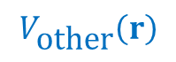
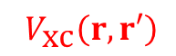
Illustration of Many-body perturbation theory(MBPT)
Example:
$$V_{\text{xc}}\left(r,r′\right)$$
$$V_{\text{other}}\left(r\right)$$
Time-axis

Slide 29
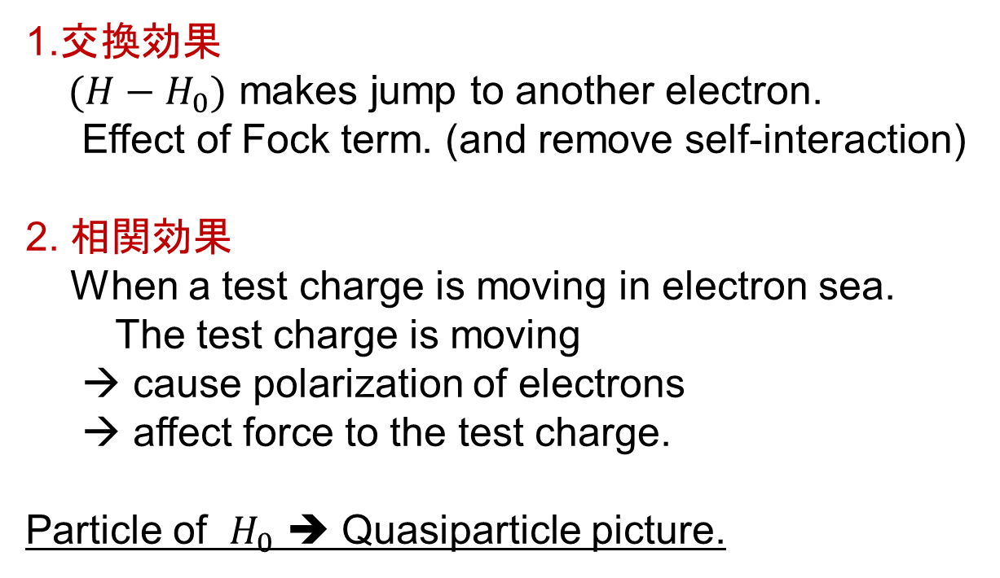
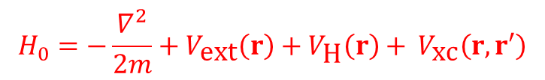
GW approximation
We concentrate on how${ G}_{0}$ is modified by $H_{0}+(H−H_{0})$
We assume $H_{0}$ is not so bad as starting point…
$$H_{0}=−\frac{∇^{2}}{2m}+V_{\text{ext}}\left(r\right)+V_{\text{H}}\left(r\right)+ V_{\text{xc}}\left(r,r′\right)$$
1.交換効果
${(H−H}_{0})$ makes jump to another electron.
Effect of Fock term. (and remove self-interaction)
2. 相関効果
When a test charge is moving in electron sea.
The test charge is moving
→ cause polarization of electrons
→ affect force to the test charge.
Particle of $H_{0}$ ➔ Quasiparticle picture.

Slide 30
GW approximation ： １電子波動関数の時間発展
Start from any H₀
1.
2.
3.
e,g. = H ^{LDA}
Polarization function
W in the RPA
(time-dependent Hartree approx.)
Notes:
This is the procedure for GW approximaiton.
At first, let me explain the procedure for the GW approximaiton.
You can start from any static H0. It can contain non-local potential.

Slide 31
Self-energy（Many-body effect is downfolded into one-body propagetor）
4.
Self-energy が「交換相関」を与える。
interpretation１：exchange hopping＋electron moving is other electrons
2: screened Coulomb interaction + Coulomb hole
G₀ → n →V^{H} also

Slide 32
QSGW: How to determine better H₀ ?
$$H(ε_{i})|\left.φ_{i}(r\right)〉=ε_{i}|\left.φ_{i}(r\right)〉$$
It is not so easy to treat energy-dependent potential!
An average procedure
(not shown here)
This idea is supported by Quasiparticle picture (Landau-Silin’s).

Slide 33
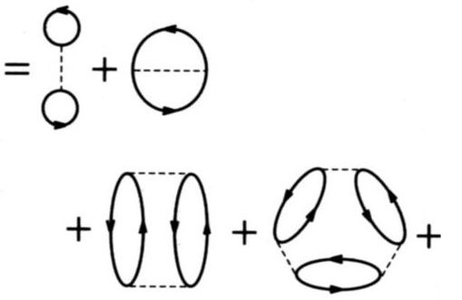
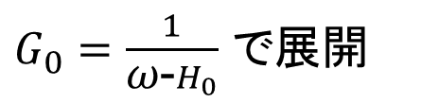
GW and the “RPA total energy”
$G_{0}=\frac{1}{\text{ω}\text{−}H_{0}}$ で展開
…
This is one-shot GW
Notes:
Let me explain minimum on the GW approximaiton.
RPA total energy.
This is a key point to interpret the meanings of GW approximation for localized orbitals.
I may say many researchers do not care about this, and apply GW in a wrong manner.
Historical reason, there is consusion about what Ei means...

Slide 34
Non-local potential term (as Fock exchange term) is important.
I. Localized electrons ← LDA+U type effect
(Onsite non-locality. self-interaction included).
It can break time-reversal symmetry → No orbital moment.
II. Extended electrons ← GW type effect for semiconductor.
Important to describe band gap. Off-site non-locality.
(required to distinguish “bonding orbital”
and “anti-bonding” orbitals. ) →next page
Notes:
So, I want to emphasise importance of Non-locality in GW approximaiton.
This is missing in LDA/GGA calculations.
Roughly speaking, its effects are devided into these two. Effects.
You may say this is LDA+U type effect.

Slide 35
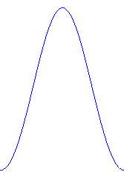
Schematic explanation on off-site exchange
If
Bonding ＨＯＭＯ
Anti-Bonding, ＬＵＭＯ,
square of them are the same.
Local potential can not distinguish
LUMO and HOMO.
Notes:
No

Slide 36
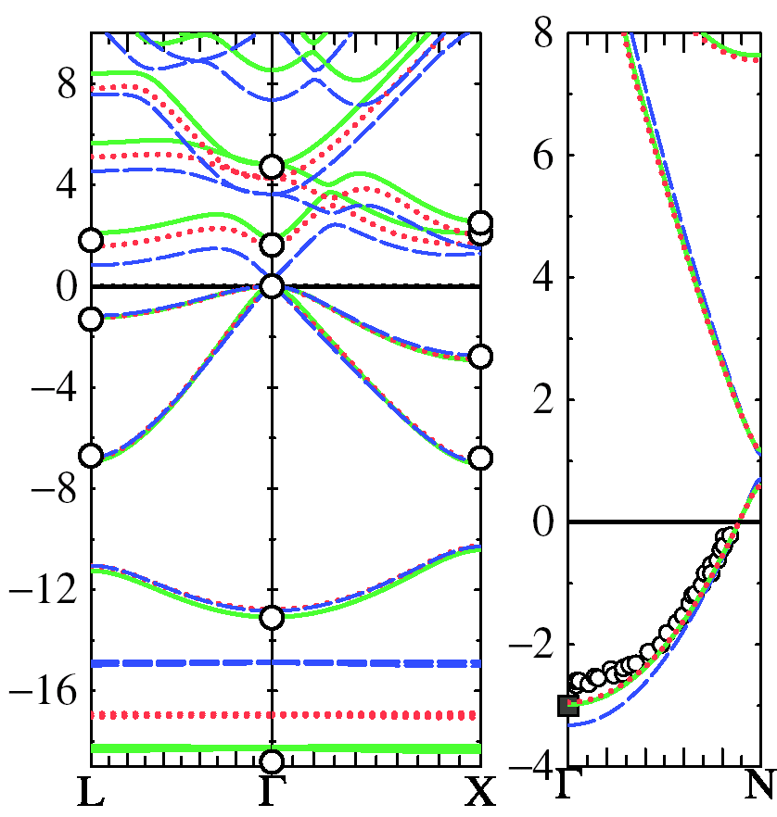
sp bonded systems
LDA: broken blue
QSGW: green
G^{LDA}W^{LDA}: Dotted red
O: Experiment
m* (QSGW) = 0.073
m* (LDA) = 0.022
m* (expt) = 0.067
Na
GaAs
Gap too large by ~0.3 eV
Band dispersions ~0.1 eV
Na bandwidth reduced by 15%
Ga d level well described

Slide 37
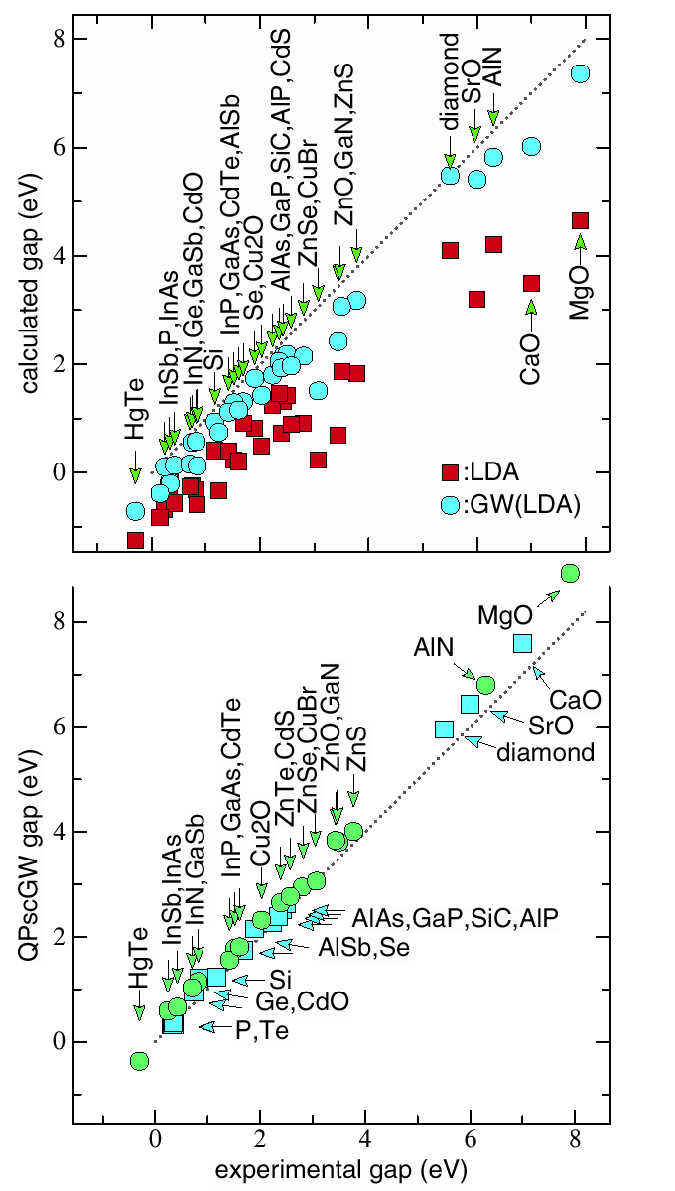
BAND GAP
LDA, one-shot GW
Calculated(eV)
QSGW
(we see systematic
over estimation).
D.Deguchi，K.Sato,H.Kino，TK（JPSJ，arXiv:1512.06930)

Slide 38
金属的なもの→ＱＳＧＷでＯＫ．
ハイブリッド法では場合によりうまくいかない。

Slide 39
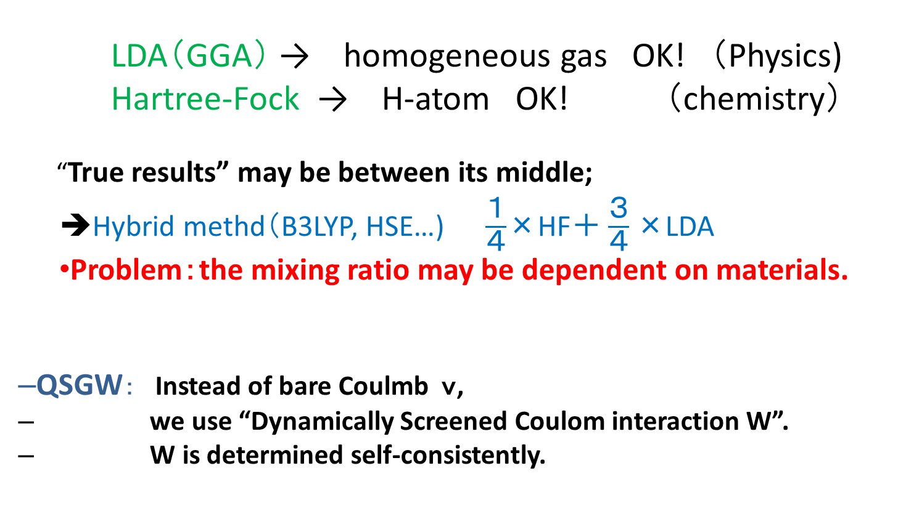
Physics in QSGW
LDA（GGA） → homogeneous gas OK! （Physics)
Hartree-Fock → H-atom OK! （chemistry）
“True results” may be between its middle;
➔Hybrid methd（B3LYP, HSE…) $\frac{１}{４}$×HF＋ $\frac{３}{４}\text{×}$LDA
Problem：the mixing ratio may be dependent on materials.
QSGW： Instead of bare Coulmb ｖ,
we use “Dynamically Screened Coulom interaction W”.
W is determined self-consistently.
Independent-particle theory where we take into account
the charge fluctuation at the RPA self-consistently.
Notes:
（線形応答のRPAで）でまじめに計算した
Hedinの
自己エネルギー項、エネルギー依存性がある。

Slide 40
Why we need ＱＳＧＷ？
We need good independent-particle picture in order to calculate linear responses (magnetic optical, transport…).
H0 (eigenvalue and eigenfunctions) are required.
＊ Band gap, Effective mass
＊Relative position of levels.
ＬＵＭＯ－ＨＯＭＯ, Fermi energy…
Metal
Molecule
ＬＵＭＯ
Molecule on
top of metal.
Fermi energy
ＨＯＭＯ

Slide 41
(12a.u.)³cell
LUMO
LUMO
HOMO
HOMO
計算の収束性は不明．．．

Slide 42
ZnO
Black:QSGW 3.87eV
Red:LDA 0.71eV
Green:G^{LDA}W^{LDA} (Z=1,Offdiagonal included) 3.00eV
Blue：e-only self-consistency 3.64eV
Experiment(+correction) 3.60eV
Kotani et al PRB76,165106(2007)
Notes:
Our main result is by the black line shown here.
>Red LDA.
Green one-shot (including off-diagonla part)
E-olny (disentanglement problem).

Slide 43
d systems
“No Pushing down 3d-band’’ in GW.
Notes:
As for Cu case, we did not see “pushing down effect of 3d level”.
Especially NiO and MnAs, we have good agreement with experiment.
It was poor in LDA.

Slide 44
NiO
Black:QSGW Red:LDA Blue: e-only
Notes:
E-only poor. Valence part is changed little from LDA.

Slide 45
NiO MnO dos
Black:t2g Red:eg
Red(bottom): expt
Notes:
As for Cu case, we did not see “pushing down effect of 3d level”.
Especially NiO and MnAs, we have good agreement with experiment.
It was poor in LDA.

Slide 46
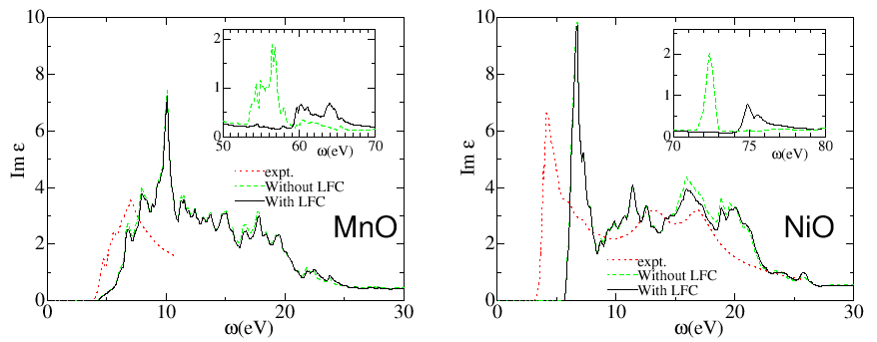
NiO MnO dielectric
Black:Im eps with LFC Red:expt
Notes:
As for Cu case, we did not see “pushing down effect of 3d level”.
Especially NiO and MnAs, we have good agreement with experiment.
It was poor in LDA.

Slide 47
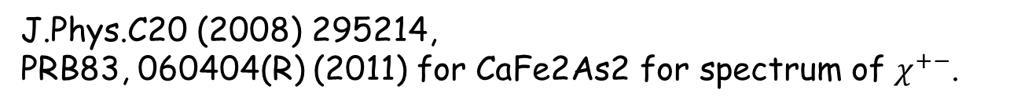
Spin wave dispersion based on QSGW

Slide 48
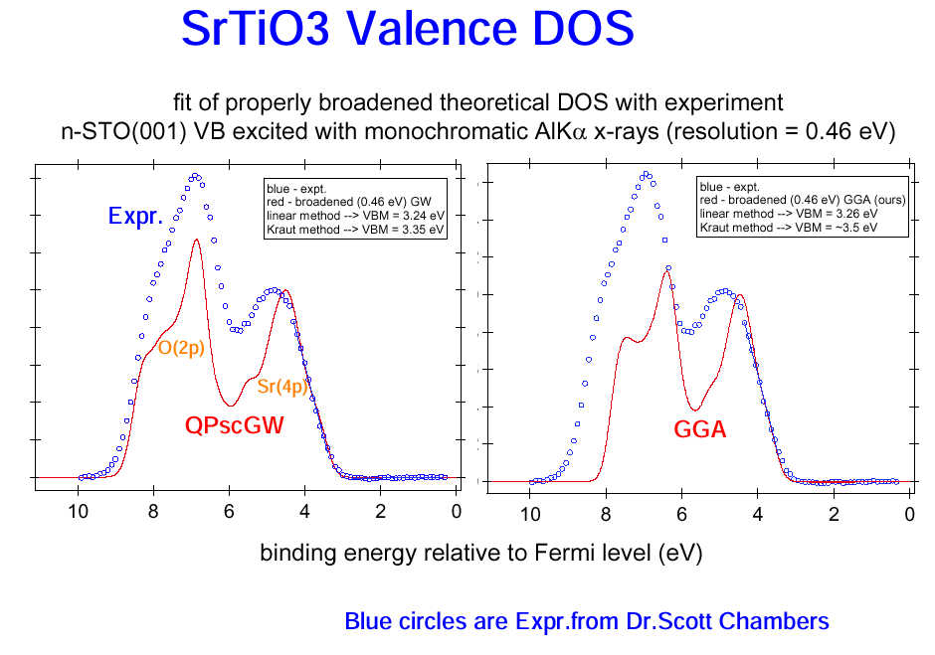
srtio3
QSGW
S. A. Chambers et al, Surface Sci 554,81-89 (2004)
Notes:
To determine the Fermi energy.

Slide 49
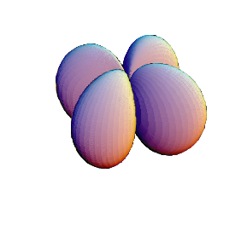
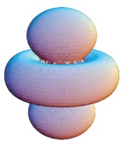
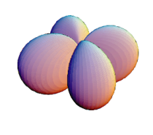
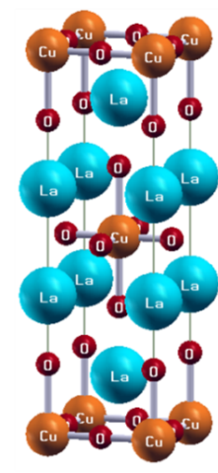
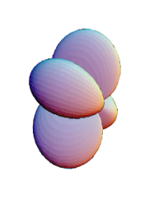
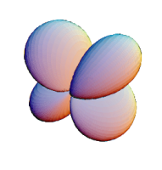
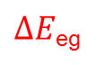
Electron configuration
lift of degeneracy of 3d orbitals due to
crystal field
x²-y²
e_{g}
$∆E$_{eg}
3z²-r²
[3d]
Cu atom
t_{2g}
xy
cubic
(regular
octahedron)
yz, zx
tetragonal
(elongated
octahedron)
Around Ef, we have two eg bands.

Slide 50
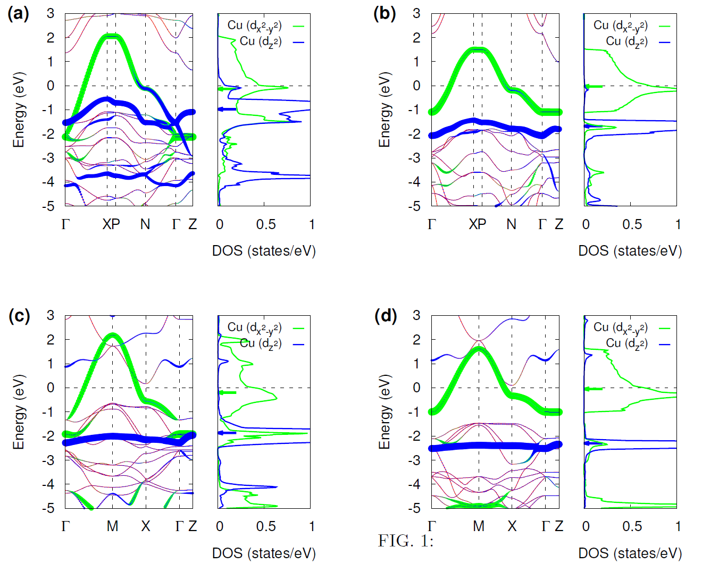
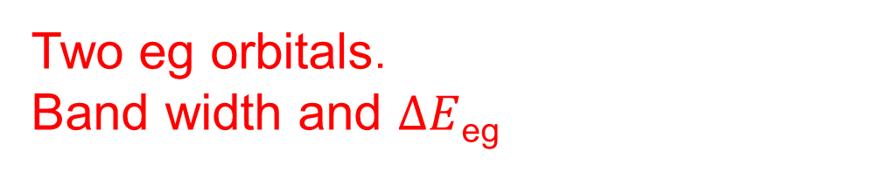
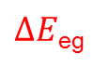
Band structure:
Two eg orbitals．
Band width and $∆E$_{eg}
doi:10.1038/srep12050
La2CuO4(VWN)
La2CuO4(QSGW)
$∆E$_{eg}
HgBa2CuO4(VWN)
HgBa2CuO4(QSGW)

Slide 51
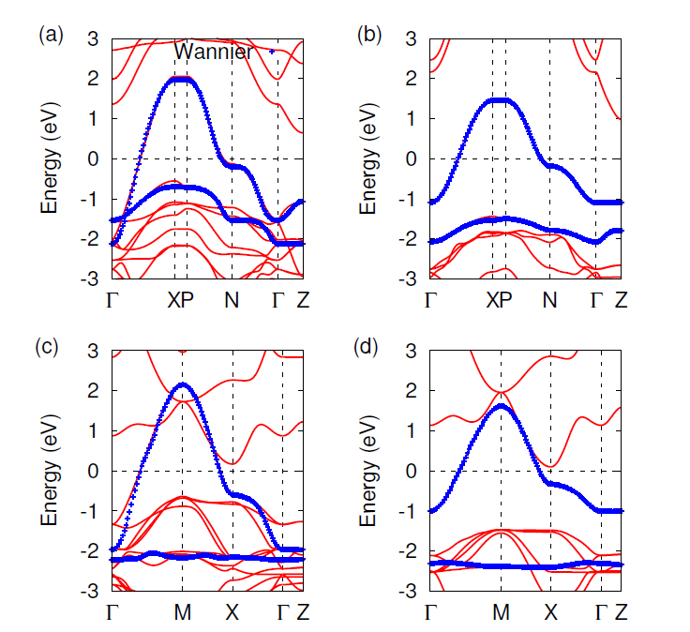
Wannier function method. Extract tight-binding parameters
La2CuO4(VWN)
La2CuO4(QSGW)
HgBa2CuO4(VWN)
HgBa2CuO4(QSGW)
Miyake’s Maxloc Wannier code is re-implemented(TK and H.Kino）．

Slide 52
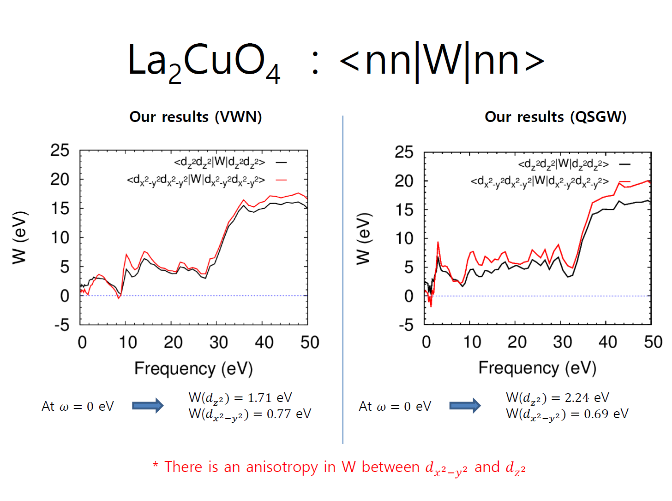
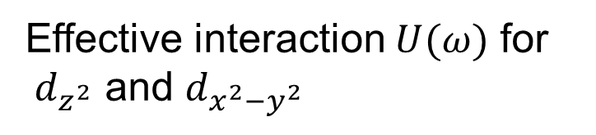
Effective interaction $U(ω)$ for
$d_{z^{2}}$ and $d_{x^{2}−y^{2}}$

Slide 53
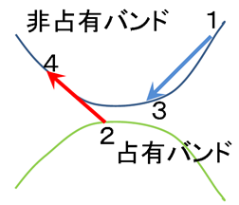

Impact ionization rate(auger process)
Fermi’s Golden rult → transition rate. Sum up for all final states. Matrix element of transition is
＜1,3｜electron-electron interaction｜4,2＞
（Energy conservation and Momentum conservation）
Unoccupied band
Occupied band
Notes:
エネルギーと運動量保存がある．
エネルギー

Slide 54

InAs impact ionization rate (=auger process = high energy electron lose energy with e-h pair)
direct gap 0.38eV
2 3 4 5
eV
Present model: Sano and Yoshii JAP77 2020 (1995)
Notes:
Impact ionization rare is the life time of electrons caused by electron-electron scattering.
It is calculated from the imaginary part
of the self-energy.
Auger effect.

Slide 55
YH3(fcc structure 6x6x6)
GGA
QSGW
L Γ X
L Γ X

Slide 56


CuGaSe2 (eight atoms in cell, 2x2x2. ~3hours per iteration by single core)
1shotGW
QSGW
T
Γ
N
T
Γ
N
Band gap GGA:0.4eV, GW(1shot noZ) 1.37 eV, QSGW(1.79eV) Exper. 1.63, 1.67, 1.73eV
Notes:
実験のバンドギャップは1.63, 1.67, 1.73eVといったところのようで、1.67eVのH¥"{o}rigらの論文(W. H¥"{o}rig, H. Neumann, B. Schumann, and G. K¥"{u}hn, phys. stat. sol. 85 (1978) K75 )が引かれることが多いようです。 計算ではGGAでは0.399eV, GWの1shotで1.37 eV, self-consistentに回した計算で 1.79 eVなんだと思います。lmf の結果のband gapの所を見たのですがこれでよいでしょうか？ バンドプロットの全体的な様相としてはどれもそれほどは変わりませんが、バンドギャップのところと、Cu-3d と Se-3p の混成でできているバンドの 分裂がGGAに比べて大きく出ていることと、それからGa-SeのボンドがつくるバンドがGGAに比べて押し下げられているいるのが顕著なように 思います。 Ga-SeのバンドはPhotoemissionの実験ではvalenceのトップから 7.35eVのところにあると見積もられていて(M. Turowski, G. Margaritondo, M. K. Kelly and R. D. Tomlinson, Phys. Rev. B 31 (1985) 1022) 計算の結果はGGAを改善する方向に動いていて、この値に近いと いえると思います。

Slide 57
CuInS₂ band gap（eV)
Band gap for CuAB₂ （eV)
A B | S | Se
Al | 3.62 (3.49) | 2.91 (2.67)
Ga | 2.83 (2.43) | 1.69 (1.68)
In | 1.22(u=0.22)1.48(u=0.23) (1.53) | ---- (1.04)
0.22 0.23 u
Experiments in (…)
J.Vidal, PRL 104, 056401 (2010)
3x3x3 calculation(need check)
Notes:
We usually expect
Internal parameter problem?
CuGaSe (1.4eV)?

Slide 58

PdO(tetragonal , four atoms per cell 3x3x2 calculation , 1hour per iteration )
GGA
QSGW
Γ X M Γ Z R A Z
Γ X M Γ Z R A Z
Band gap about 0.7 eV

Slide 59

LaNiO3
M.J.Han, H.Kino, T.K (arXiv:1402.4915)
Notes:
LaNiO3/LaAlO3

Slide 60


Slide 61


Slide 62
summary
Mean field theory and excitation energy
LDA, Hartree-Fock and QSGW
Janak theorem, finite vs.infinite system
RPA total energy
QSGW method
Some Results
Band gap, GaAs and Na, Cu
NiO, Spin Wave, ZnO, LaMnO3,
InAs (impact ionization), YH3, CuGaSe2,PdO
How QSGW works for atoms and molecules?
See F.Bruneval J.Chem.Phys 136,194107(2012)

